Slide 1
Recognizing and Responding to Chemical-Assisted Suicides

Slide 2
IAFC Webinar
Live webinar presented by International Association of Fire Chiefs (IAFC) on March 31, 2016
Webinar material developed by IAFC, National Library of Medicine and AlphaTRAC, Inc.
Recorded webinar available at:
https://iafcevents.webex.com/iafcevents/lsr.php?RCID=44f9aaafcbf24c789c58785bc9f71f90

Slide 3
Get Involved
www.iafc.org
www.iafc.org/getinvolved
www.iafc.org/elearning
www.iafc.org/webinars
www.iafc.org/conferences

Slide 4
The NIH CHEMM Project
National Library of Medicine / National Institutes of Health
Chemical Hazards Emergency Medical Management (CHEMM) Website
http://chemm.nlm.nih.gov
Notes:
This webinar is based on research and information collection conducted under the sponsorship of the National Institutes of Health National Library Of Medicine.
You are probably already familiar with the WISER emergency response tool, which is developed and provided by this group at NLM.
NLM also operates a key resource for the emergency response community, called the Chemical Hazards Emergency Medical Management website, or CHEMM.
Here’s the URL for the CHEMM site.

Slide 5
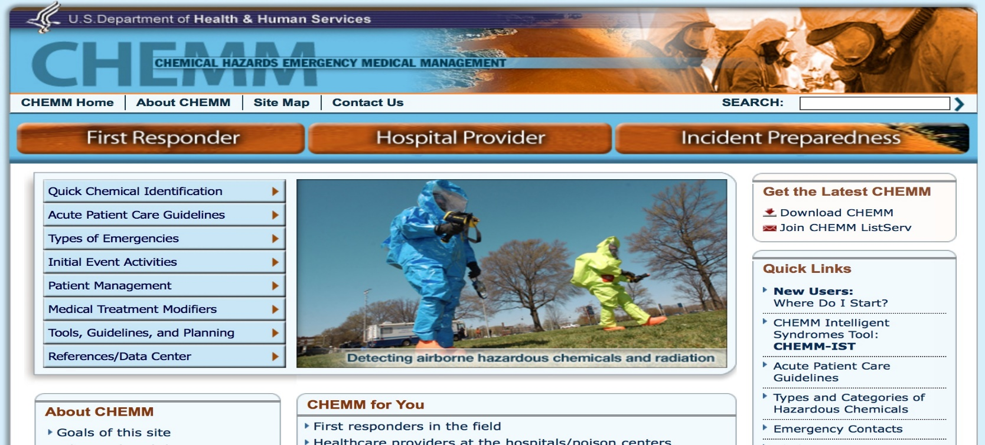
Notes:
CHEMM pulls together in one location a wide-ranging set of resources, information and tools to support response to chemical emergencies.
Although primarily focused on chemical emergencies with medical consequences, there is a wealth of information applicable to all kinds of chemical events.

Slide 6
9 News Denver Story on Chemical Suicides
Notes:
One type of chemical emergency with medical emergencies is a chemically-assisted suicide – our topic for today.
I think this news clip sets the stage…

Slide 7
Chemically-Assisted Suicides - Overview
Combination of common consumer products to commit suicide through toxic exposure
Route of exposure may be ingestion or inhalation
Airborne exposure more hazardous to responders and public
80% of responses result in first responder exposure
Notes:
Let’s take a 10,000 ft. view, then drill down.

Slide 8
History
First used in Japan in 2007
Rapidly grew to 1000’s of cases
Introduced to U.S. in 2008 through Internet
Steadily growing incidence in U.S.

Slide 9
Why Is It Popular?
Instructions are available on Internet
Components are easily obtained
Process is easy
Notes:
… also
There a high “success rate”
It’s hard to back out

Slide 10
Common Approaches
Most often used in confined spaces
Automobiles
Closets
Bedrooms
Bathrooms

Slide 11
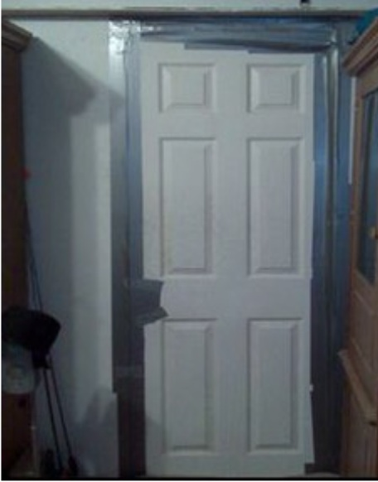
Usual MO
Victim:
Obtains components
Seals confined space
Posts warning signs
May call 911
Mixes components
Expires within 5 – 10 minutes

Slide 12
Chemicals of Choice
Hydrogen Sulfide
Hydrogen Cyanide
Carbon Monoxide
Pesticides
Ingested Cyanide (Sodium and Potassium Cyanide)
Ingested Phosphide (Aluminum or Zinc Phosphide)
Ingested Azides (Sodium Azide)
Notes:
Phosphides - rodenticide, insecticide, and fumigant
Sodium Azide – pest control for agriculture, older air bags

Slide 13
Other Chemicals (Less Likely)
Other varieties of pesticides
Toxic chemicals in aerosol cans
Toxic liquids that have been attached to an airborne dispersion device (such as a sprayer)

Slide 14
Hydrogen Sulfide – the Most Common Chemical
Colorless gas
Smell of rotten eggs
Chemical asphyxiate and chemical irritant
Renders cells unable to use oxygen – suffocation at cellular level

Slide 15
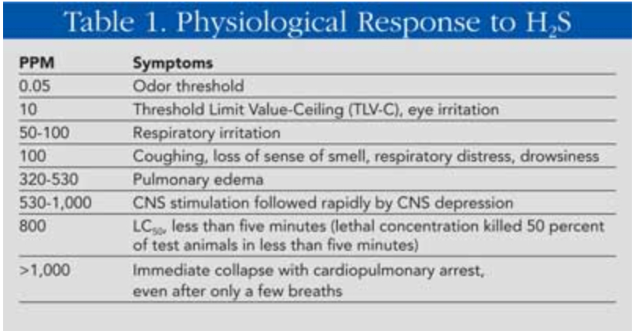

Slide 16
High Risk to Responders!!
H2S levels can exceed 1,000 ppm in a 4-door sedan

Slide 17
Examples
2014: H2S in barricaded room
2011: Mixture in car stirs up during response
2009 & 2011: Aluminum phosphide in Loudoun County, VA
2014: H2S in apartment with victim rescue

Slide 18
IAFC National Near Miss System
http://www.firefighternearmiss.com/
http://www.firefighternearmiss.com/Reports?id=6430

Slide 19
Recognizing a Potential Chemically-Assisted Suicide
Reported symptoms
911 caller
Bystanders
Vehicle situation
“Check the Well Being” situation
Notes:
The key to avoiding exposure for a first (or later) responder is to recognize that a potential chemically-assisted suicide incident exists and to take appropriate actions

Slide 20
Indicators: Reported Symptoms
Notes:
You can get some indication from reported or observed symptoms – 911 callers, witnesses at scene

Slide 21
Indicators: Vehicle Situation
Warning sign(s) taped to the vehicle door or placed inside
Smell of rotten egg or sulfur
Smell of bitter or burnt almonds

Slide 22
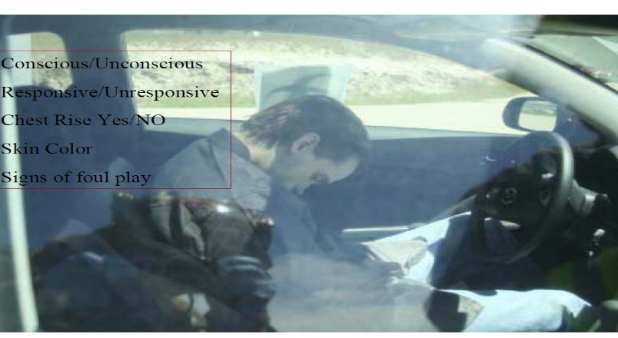
Indicators: Vehicle Situation
Unresponsive subject inside the vehicle
Pennies in the vehicle or console area will be tarnished with residue
Empty household cleaning containers on the floor board or seat

Slide 23
Indicators: Vehicle Situation
One or more large buckets for mixing the acid base and sulfur chemical
Vehicle’s inside door handles remove
Yellow-green or white residue on the seats or on the dashboard

Slide 24
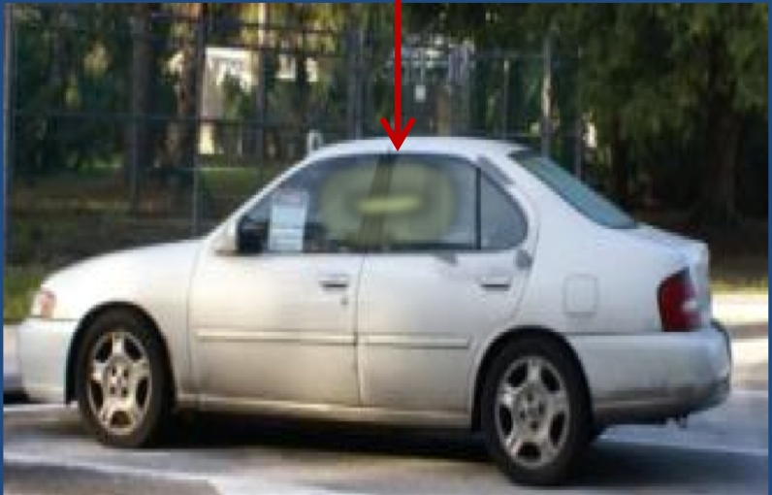
Indicators: Vehicle Situation
Duct tape to cover air vent
Tools to mix the chemicals
Windows fogged or tinted with yellow/green residue

Slide 25
Indicators: Check Well Being Call
Masking tape or towels sealing a door (may be on inside of door and not visible)
Smell of rotten egg or sulfur
Smell of bitter or burnt almonds

Slide 26
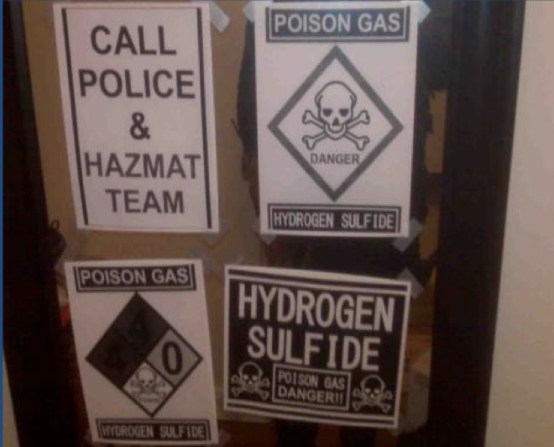
Indicators: Check Well Being Call
Suicide note taped to the door or mirror
Warning sign(s) taped to the mirror or door

Slide 27
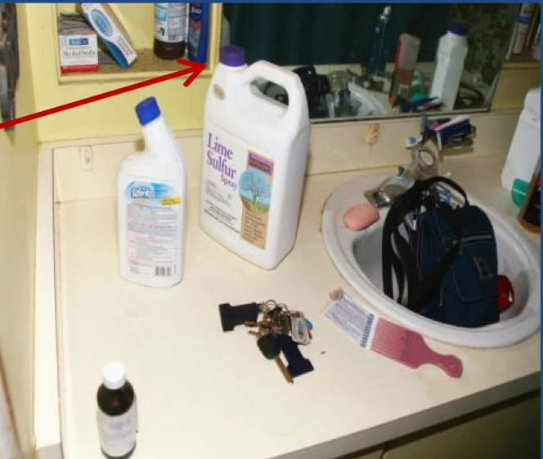
Indicators: Check Well Being Call
Empty household cleaning containers that contain acid and sulfur
One or more large buckets to mix the chemicals

Slide 28
Responding to Chemical Suicide
Treat as high hazard HAZMAT event with contaminated victim(s) requiring rescue
Use your department protocols for this type of response

Slide 29
Responding – Analyze and REACT
Look for Indicators
Recognize potential for chemical suicide
React immediately – your life may be at risk!
Back off
Immediately employ SCBA, turnout gear, 4-gas monitor for reconnaissance (at a minimum)

Slide 30
Responding – Plan
Consider / select strategy
Approach to vehicle will be different than approach to structure
Call in the right team
Select PPE
Obtain air monitoring equipment
Select decontamination approach(es)

Slide 31
Responding – Plan
Implement agency HAZMAT protocols
Plan for site safety
Plan for site security
Use risk-based response approach
Consider confined space volume and possible contaminant concentrations

Slide 32
Responding – Plan
Plan to ventilate and enter room / vehicle
Plan to mitigate HAZMAT spread
Plan to remove and treat victim
Evaluate risk to public and plan for protective actions

Slide 33
Responding – Implement
Secure the scene
Use hand line as appropriate
Ventilate / change the environment
Conduct air monitoring
Treat the victim (if viable)
Transport the victim (hospital or morgue)

Slide 34
Responding – Implement
Decontaminate
Victim
Responders
Others affected
Equipment

Slide 35
Responding – Implement
Coordinate with Police (work out a plan beforehand)
Treat as crime scene!
Minimal disturbance
Protect evidence

Slide 36
Responding – Implement
Maintain situational awareness
Might be deliberate instead of suicide
May be additional devices
Re-release may reoccur
Off gassing will occur!

Slide 37
Risks to Responders
Direct exposure to toxic gas
Opening space may not disperse gases!
Off gassing from site
Off gassing from victim
Bodily fluids from victim
HAZARDS MAY PERSIST FOR HOURS AFTER EVENT

Slide 38
IAFC Resource – San Diego HIRT
San Diego Hazardous Incident Response Team (HIRT)
Conducted chemical suicide study
Goal: determine the risk to the public and first responders
Available at: IAFC HAZMAT Fusion Center
www.hazmatfc.com/Resources/Training-Packages/Chemical-Suicide-Package,
Notes:
Because of the growing threat, research is being conducted to evaluate these kinds of events and develop appropriate SOGs. I’m going to turn it over to Joe to talk about a particularly useful study conducted by a national leader in Response and provided to the response community by the IAFC.

Slide 39
San Diego HIRT Recommendations
Secure a perimeter of 150’
Use fire fighter turnouts for reconnaissance and monitoring of the vehicle
Look for secondary devices
Look for yellow liquids and containers inside the vehicle

Slide 40
San Diego HIRT Recommendations
Vehicle will not be at flammable limits and cannot catch fire
Use the combustible gas indicator for perimeter monitoring
Use photo ionization detector for monitoring cracks and crevices of the vehicle for higher concentrations
Vehicle can be vented with a 150’ perimeter
Gas will dissipate in 15 minutes

Slide 41
San Diego HIRT Recommendations
Once vented ensure the Medical Examiner has provided approval to remove the chemical containers
Moving the mixing bucket can cause lethal levels of hydrogen sulfide gas to be generated
Mixing bucket should be handled in full Level “B” chemical protective clothing

Slide 42
San Diego HIRT Recommendations
Neutralize with fast setting concrete
Will allow the agency to treat the solidified waste as a non-hazardous waste

Slide 43
IAFC Chemical Suicide Response Card
Available at: IAFC HAZMAT Fusion Center
www.hazmatfc.com/Resources/Training-Packages/Chemical-Suicide-Package,
Addresses 18 response topics for 6 chemicals
Notes:
Here’s another excellent resource developed and provided by the IAFC. Joe, back to you.

Slide 44
Chemicals Addressed
Detergent (Hydrogen Sulfide)
Hibachi (Carbon Monoxide)
Pesticide (Based on Malathion)
Cyanide (Sodium and Potassium Cyanide ingested)
Phosphide (Aluminum or Zinc Phosphide ingested)
Azides (Sodium Azide ingested)

Slide 45
Response Topics
Dispatch Triage
First Responder
Hazmat Teams
Indicators
Chemical Description
Odor
Odor Threshold
Evac /Isolation Distance
Flammability
PPE First Responders
PPE HAZMAT Teams
Instrumentation
Toxicity
Deceased Skin Color
Molecular Weight
Symptoms
Emergency Decon
Transport and ER

Slide 46
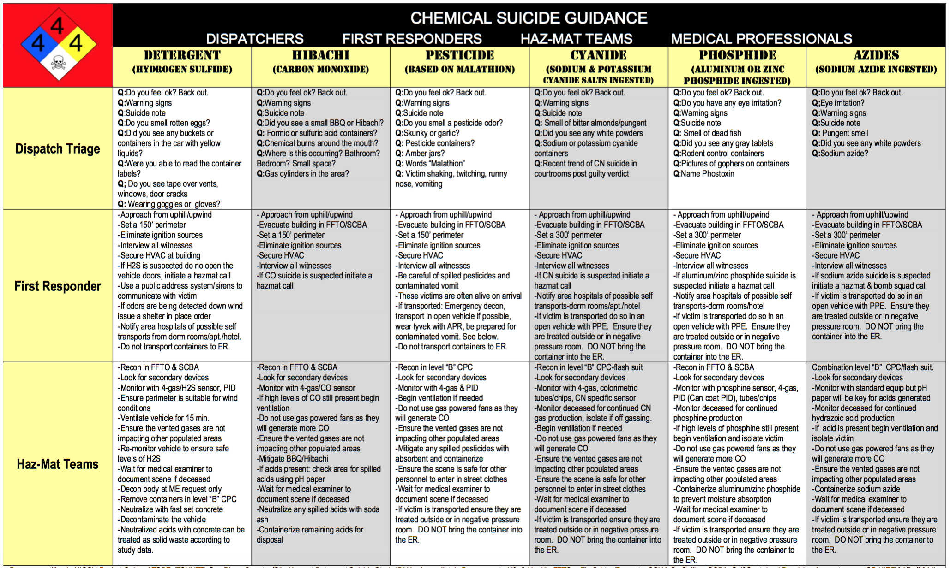
Example – Page 1

Slide 47
Other Training / Information References (CHEMM)
Chemical Assisted Suicide: Responder Information (PDF – 198 KB) (HAZMAT FC)
Chemical Suicides: A New Threat for Responders
Chemical Suicides: Dangers for First Responders (CBRNE Resource Network)
Chemical Suicides in Automobiles (CDC)
Chemical Suicides: Identification Guide for 911 Communications (PDF – 1094 KB) (CFIX)
Coffee Break Training – Hazardous Materials: Chemical Assisted Suicide (PDF – 503 KB) (USFA, FEMA, NFA)
Hydrogen Cyanide (OPCW)
Hydrogen Sulfide Suicide Trend: First Responder Safety Update (PDF – 1114 KB) (CFIX)
The Chemical Suicide Phenomenon: Where Is It Headed? (PDF – 255 KB) (NY State DHSES)
Notes:
Here are some key additional resources. You’ll be able to access them through the NLM’s CHEMM site.

Slide 48
Thank You!
C. Reed Hodgin
AlphaTRAC, Inc.
rhodgin@alphatrac.com
(303) 669-2564
Joe Kratochvil
IAFC
kratochvil@iafc.org
(703) 896-4857

